Slide 1

Virtual Agent Chatbot
VA.gov | Department of Veterans Affairs
Automated Content and Claims Feature Research
Shane Strassberg// Dec 2021

Slide 2
Purpose for research
Vet preference for drupal content response
Link
Preview
Full
Feedback for claims feature
Any missing info
Comprehension of buttons
3. Updated Disclaimer location

Slide 3

Participants
Seven (7) Veterans, Age 35-65+
Five (5) male
Two (2) female
Race
Six (6) White
One (1) Black
Education
One (1) Some college
Two (2) Associates, Trade, or Vocational
Four (4) Master’s degree
Assistive Tech
One (1) Speech Input (Dragon)
One (1) Hearing aid

Slide 4
How this research maps to the Veteran journey
Virtual Agent Chatbot | Dec 2021
Self-Service
Research benefits/healthcare
Anonymous conversations
Escalation to real person when ready
Trust in secure authentication
Bridge between MyVA/My Health
Better UX for accessibility
Reinventing myself
Joining
Serving
Getting out
Starting up
Taking care of myself
Retiring
Aging
Dying
Putting down roots
For a fully detailed Veteran journey, go to https://github.com/department-of-veterans-affairs/va.gov-team/blob/master/platform/design/va-product-journey-maps/Veteran%20Journey%20Map.pdf
Serving and separation
Living civilian life
Retiring and aging

Slide 5
OCTO-DE goals that this research supports
Virtual Agent Chatbot| Dec 2021
Supported
Not supported
Veterans and their families can apply for all benefits online
Veterans and their families can find a single, authoritative source of information
Veterans and their families trust the security, accuracy, and relevancy of VA.gov
Veterans can manage their health services online
VFS teams can build and deploy high-quality products for Veterans on the Platform
Logged-in users have a personalized experience, with relevant and time-saving features
Logged-in users can update their personal information easily and instantly
Logged-in users can easily track applications, claims, or appeals online
Completion rate of online transactions
Percent of applications submitted online (vs. paper)
Veteran satisfaction with VA.gov
Benefit use and enrollment, across all business lines
Benefit value (in $) delivered from online applications or transactions
Number of VA.gov users as a function of total Veteran population
Usage of digital, self-service tools
Measures to increase
Time to successful complete and submit online transactions
Time to process online applications (vs. paper)
Call center volume, wait time, and time to resolution
Time from online benefit discovery to benefit delivery
Measures to decrease

Slide 6





Vet Actions for VA Info
General
Specific

Slide 7
“
I just feel more comfortable talking to a vet or googling myself. The VA here...they’re not very helpful. I don’t know how to get to someone directly..
Black, Female Veteran, Age 35-44

Slide 8
Updated Disclaimer

Slide 9
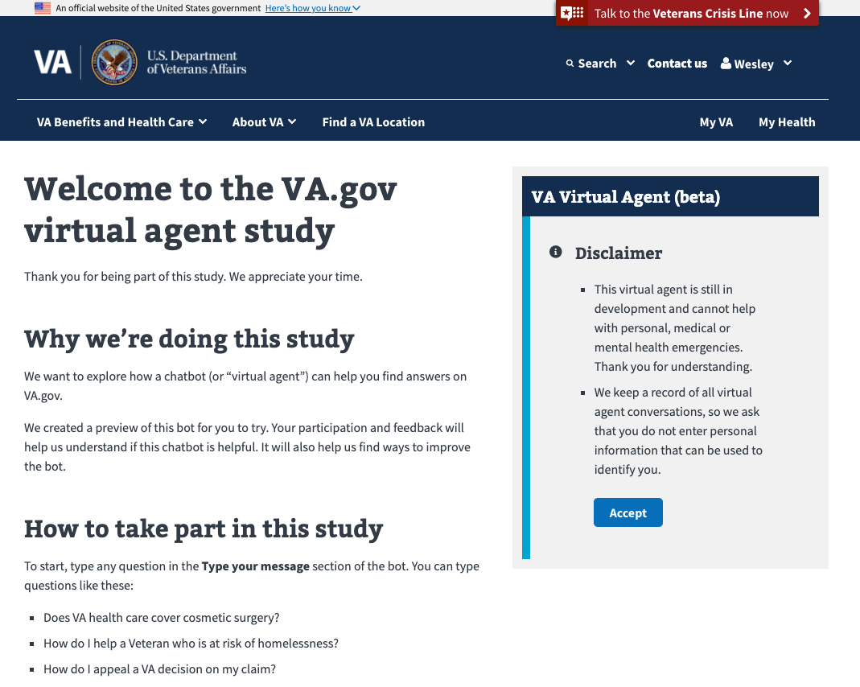

Slide 10
Drupal Response Task

Slide 11
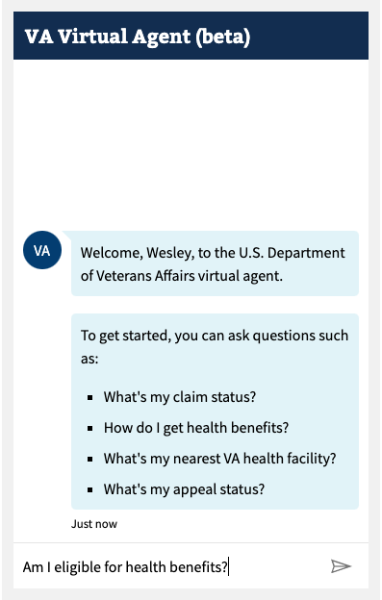
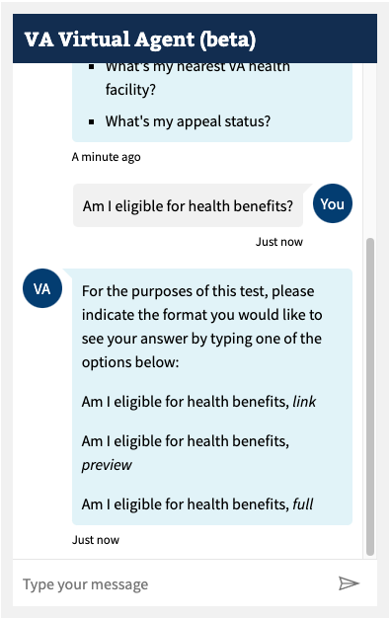

Slide 12
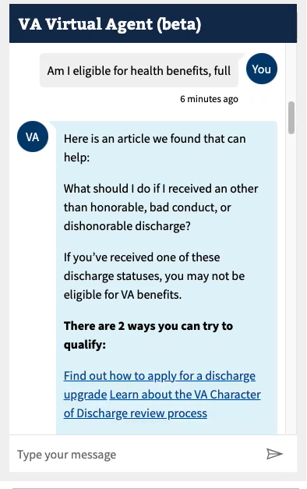
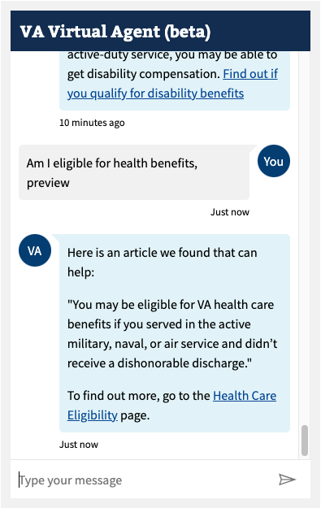
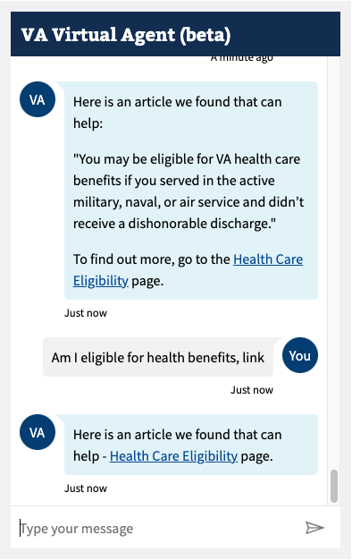

Slide 13
Key Findings
1
Vets consistently preferred the preview response
2
They felt it provided just enough context and confident it would set them down the right path
3
Full response was too much info in small space. Info was more digestible on webpage.

Slide 14
General Topic Task

Slide 15
Key Findings
1
Results for correct responses were mixed. High-traffic topics like “prescriptions,” the bot provided an accurate response to the right webpage, or a facility location would provide response to the locator tool.
2
Bot could get “confused” when asked, “Can my spouse get VA benefits?”, and provided response with link to Education and Training Benefits webpage, or when asked more obscure topics like if VA is conducting studies on CLL (Chronic Lymphomatic leukemia).
3
However, Vets were not deterred from continuing to try to use the bot to get to the right info.

Slide 16
Claims Task

Slide 17
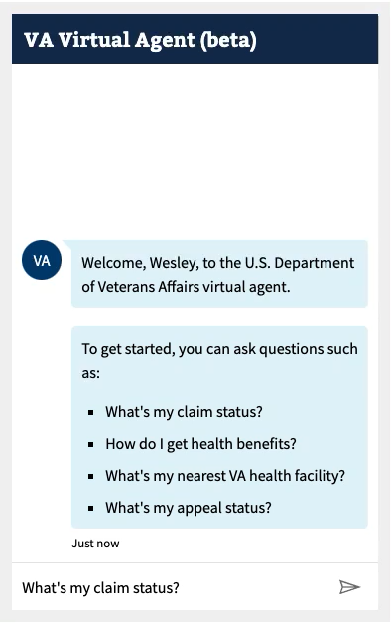

Slide 18
Key Findings
Vets understood the provided info, really liked the rep. info, and appreciated the loading text/ellipses when bot was making API call.
1
Vets thought changing “your first claim” to “your most recent” claim makes more logical sense
2
Vets thought including the type of claim, “back, toe, PTSD” would improve recognition of the claim
3
Rather than having a “See Next Claim” button, each claim could be a button
4

Slide 19
Additional Findings
Vets really liked this feature because it removes being put on hold and passed around on the phone.
1
Some confusion for “Speak to Agent” button.
2
Vets said they would chat with a live agent if they wanted more info
3
Once connected to live agent, reverify personal info for added security
4

Slide 20
Recommendations
Deploy preview drupal responses to minimize cognitive load and potential 508 issues with lots of text and links in full response
Use LUIS instead of QNAmaker for natural language processing
Include type of claim if possible for easier recognition of each claim
Change “Speak with Agent” button to “Chat with Live Agent” or “Connect to Live Agent” to minimize confusion
Prototype and test if displaying multiple claims as buttons improves the user experience

Slide 21
“
This shows potential for getting information I need quickly, simply and reliably. I would definitely use chatbot as first resource in info-finding after chatbot goes through a few more rounds of development.”
“I would 100% use the chatbot again because it allows me to work at my own pace and not be pressured for questions.”

Slide 22

Any questions?

Slide 23
Notes:
Potential Closing Slide

